Slide 1

BizTalk Accelerator for Retail
A Microsoft Service Offering

Slide 2

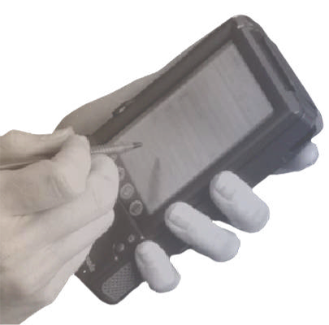
The Objective:
Business Agility for Retailers
Key Considerations
Solution Sell with Compelling ROI
Deliver real business value
Flexible, Affordable Technology Foundation
Support EAI, BI Solutions, and B2B Channel Collaboration on a .Net platform
Enterprise Level Execution
Not another box in the store

Slide 3

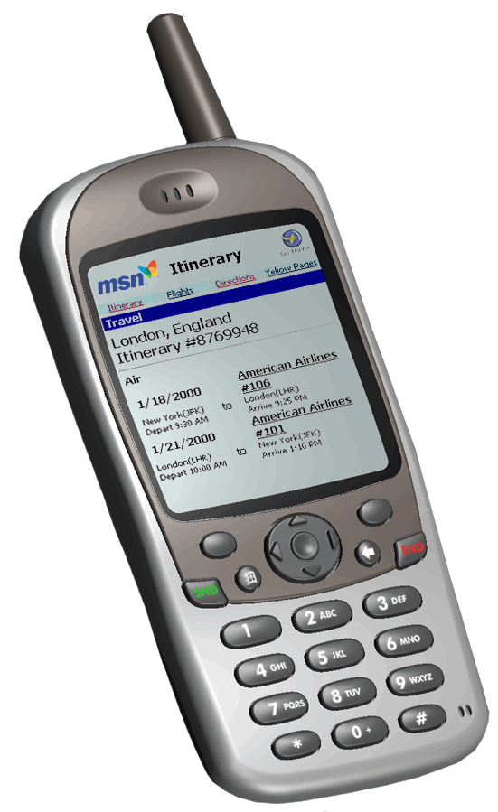

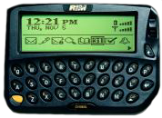
Retail Accelerator
Suppliers
IBM 4690
IBM 4680
NCR
BizTalk Server
A
P
P
L
I
C
A
T
I
O
N
S
Repl
Plan
E
N
T
E
R
P
R
I
S
E
Alloc
A
D
A
P
T
E
R
S
CRM
P
O
S
Transform
Orchestrate
Route
SA
Merch
LP
Fin
Rpt
DSS
Services
Notification
Devices
Notes:
Agile businesses thrive by quickly realigning to new market conditions. For retailers, the timely consolidation, transformation, and distribution of their sales data within and outside of their enterprise drives this capability. Within the enterprise, transaction data supports core operational systems like replenishment, merchandising, and financials, as well as business intelligence solutions like loyalty, shrink and loss prevention. Externally, manufacturers and suppliers rely on sales data to understand consumption trends, market share, and the impact of promotional activities. For retailers and suppliers, transaction data is the fuel for channel collaboration.
That said, while retailers certainly recognize the value of integrating these desperate systems, most lack the technical infrastructure and resource capacity to easily achieve these results. The BizTalk Accelerator for Retail delivers a cost effective solution to this dilemma.
The value of the Retail Accelerator is currently being demonstrated via pilot engagements with several retailers. These engagements are delivering a Consumer Demand Signal Service (CDS) which monitors merchandise turn rates and alerts store personnel of potential out-of-stock conditions. CDS will become the catalyst for a broader supply chain orchestration initiative with consumer products giant Procter and Gamble. Here again, the Accelerator’s value proposition will be further demonstrated by orchestrating the supply chain’s reaction to the real-time consumer demand (sales) data stream.

Slide 4
The Offering
Adapter Portfolio
Transaction, Item, CAO, …
Services Catalog
Consumer Demand Signal, Analytics for Retail, …
Integration Guidelines
BizTalk Accelerator for Retail
Services
Catalog
Enterprise
Applications
Partner
Collaboration
Adapter Portfolio
Notes:
The BizTalk Accelerator for Retail delivers the solution architecture and technical infrastructure for numerous business intelligence (BI), enterprise application integration (EAI), and 3rd party service opportunities in the retail space. It assumes the need for near real-time consolidation, transformation, and routing of transaction data to support these solutions. As such, either through partners or solution collateral, the offering will deliver the POS adapters to address the most common integration scenarios (in-store and enterprise level) and store automation platforms (IBM 46x0, NCR). This POS adapter portfolio will be augmented with additional data adapters for merchandising and item data. In addition, the Accelerator will include a catalog of value-add services (CDS, Notification, etc.) as well as a set of integration guidelines.

Slide 5
Solution Stack
Retail Accelerator
BizTalk Server 2000
Service Offering
Support
SQL Server 2000
Windows 2000 Server
Notes:
The specific product SKUs have yet to be determined, but below is a general look at the solution.
BizTalk Accelerator for Retail Accelerator
POS Adapters, Notification System, Services (e.g. CDS, Analytics for Retail, etc), Integration Guidelines
BizTalk Server 2000
Platform for Accelerator
SQL Server 2000
Database server for BizTalk Server
Windows 2000 Server
Core underlying platform
Optional
Host Integration Server for existing/legacy system integration
ISA (??)
Possible Third Party Software
Matra Freedom ISP
Systec Dataminer
QVS 4690 Controller Replacement
Xceed FTP Library for BTS

Slide 6
Potential Partners
POS Adapter Portfolio
  Matra Systems Freedom ISP
  Systec / MGV 4690 DataMiner
  QVS 4690 Controller Replacement
Line-of-Business Services
  Data Ventures Consumer Demand Signal Service
Infrastructure Services
  Microsoft Notification Services
  Xceed Software FTP Library for BTS
  Data Return Hosting Services
  Compaq Hosting Services

Slide 7

Pipeline
As driven by Fireball
North America
In Pilot
Meijer
Food Lion
Pilot in July
Giant
In Discussion
Target
Wal-mart
Western Europe
Tesco or Sainsbury
Latin America
Bompresco
All Markets
Early Adopters
Global Expansion
Broader Market

Slide 8


Slide 9

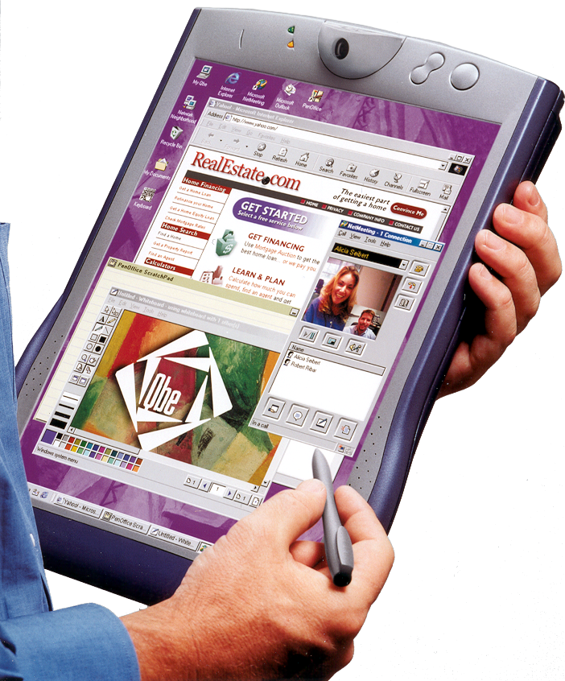

POS Adapters
BizTalk Accelerator
Services
IBM 4690
Consumer
Demand
Signal
Transform
Orchestrate
Route
IBM 4680
NCR Unity
Analytics for
Retail

